Slide 1
National Credentialing Forum
February 1, 2018
Jennifer Michael
Chief Information Officer
©2017 American Board of Medical Specialties

Slide 2

ABMS Mission
  Through Ongoing Certification
  To Serve
  Patients, Families and Communities
Setting Professional Standards
Improved Quality of Health Care
Demonstrated Expertise
Notes:
Add animated version (Dr. Irons and Dr. Nora Presentations)

Slide 3


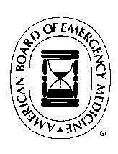
















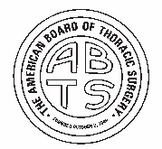

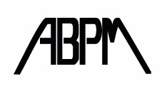
About ABMS
24 Member Boards set their MOC program requirements (in compliance with the MOC Standards) that define the education, training and additional assessment requirements for certification.
Allergy and Immunology
Anesthesiology
Colon and Rectal Surgery
Dermatology
Emergency Medicine
Family Medicine
Internal Medicine
Medical Genetics and Genomics
Neurological Surgery
Nuclear Medicine
Obstetrics and Gynecology
Ophthalmology
Orthopaedic Surgery
Otolaryngology
Pathology
Pediatrics
Physical Medicine and Rehabilitation
Plastic Surgery
Preventive Medicine
Psychiatry and Neurology
Radiology
Surgery
Thoracic Surgery
Urology

Slide 4




ABMS Board Certification and MOC
Approximately
880,000+
550,000
520,000+
practicing physicians are certified by one (or more) of the 24 ABMS Member Boards.
diplomates are currently participating in MOC.
engaged in continuing certification
Source: ABMS Certification Database

Slide 5



About ABMS
37
ABMS is the largest self-regulating group of physicians in the United States
specialties
86
Board Certified US physicians by one (or more) ABMS Member Boards
Non-certified physicians in the US
subspecialties

Slide 6


ABMS Board Certification and MOC
ABMS Member Boards set standards for certification in a particular specialty and subspecialty. The standards include necessary education, training requirements, and assessments needed.
Certification
Non-time-limited (no longer issued)
Time-limited
Continuous
    Six Member Boards have continuous certificates that do not require end dates but have reverification dates for credentialing purposes.

Slide 7
Innovations in Assessment
ABMS Member Boards are collaborating to explore how adult learning theories and emerging technologies can inform new approaches to assessment of knowledge and skills.

Slide 8
Longitudinal Assessment Pilots
ABMS is collaborating with 13 Member Boards to pilot new approaches to the recertification examination
  Web-based longitudinal assessment platforms incorporating spaced repetition to increase retention in addition to assessing knowledge and judgment
  Mobile and desktop access
  Diplomates are able to customize content/items to align with their practice
  Flexible administration in terms of completion time and place
  Immediate feedback on strengths, weaknesses, and gaps in knowledge to guide future learning
  Dashboard for real time performance monitoring

Slide 9
ABMS Boards Developing Longitudinal Assessments
CertLinkTM Boards
Colon & Rectal Surgery
Dermatology
Medical Genetics & Genomics
Nuclear Medicine
Otolaryngology
Pathology
Physical Medicine & Rehabilitation
Other Boards
Allergy & Immunology
Anesthesiology
Obstetrics & Gynecology
Ophthalmology
Pediatrics
Radiology
These Boards have announced longitudinal assessment programs for MOC Part III
Other Boards have/are developing longitudinal self-assessments for MOC Part II
Additional Boards considering

Slide 10
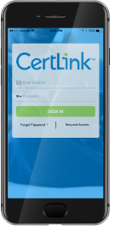
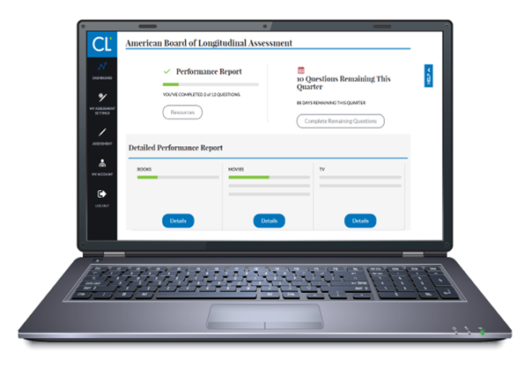
CertLink™
Mobile and web-based platform
Diplomate dashboard
Confidence and relevance ratings
Boards determine areas for diplomate customization
Diplomate feedback captured

Slide 11
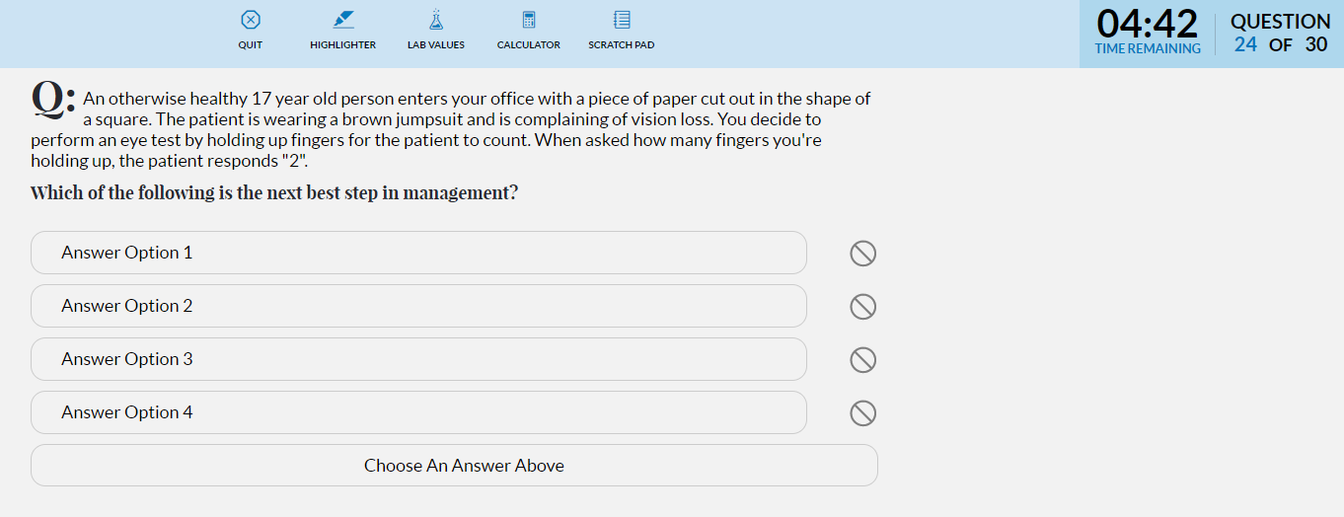
Overview of Certlink™ Assessment Delivery

Slide 12
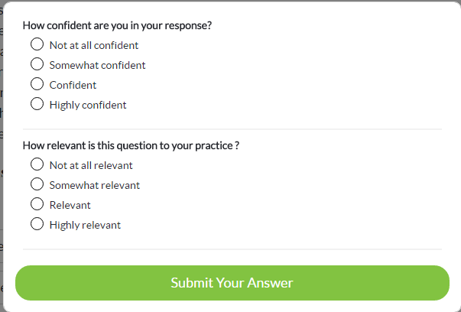
Overview of CertLinkTM Assessment Delivery

Slide 13
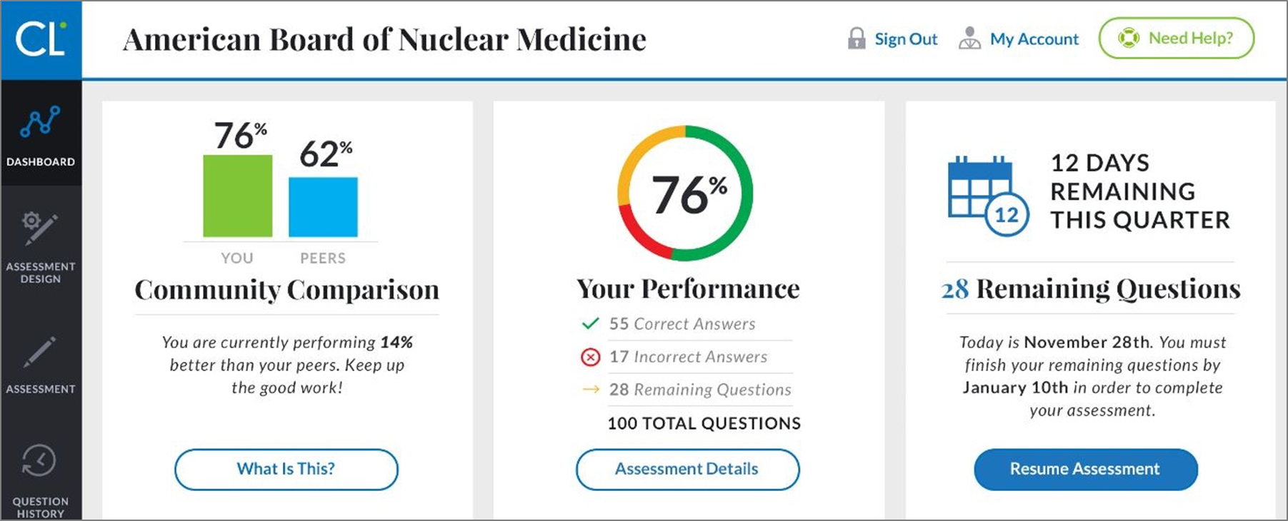
Overview of CertLinkTM Assessment Delivery

Slide 14
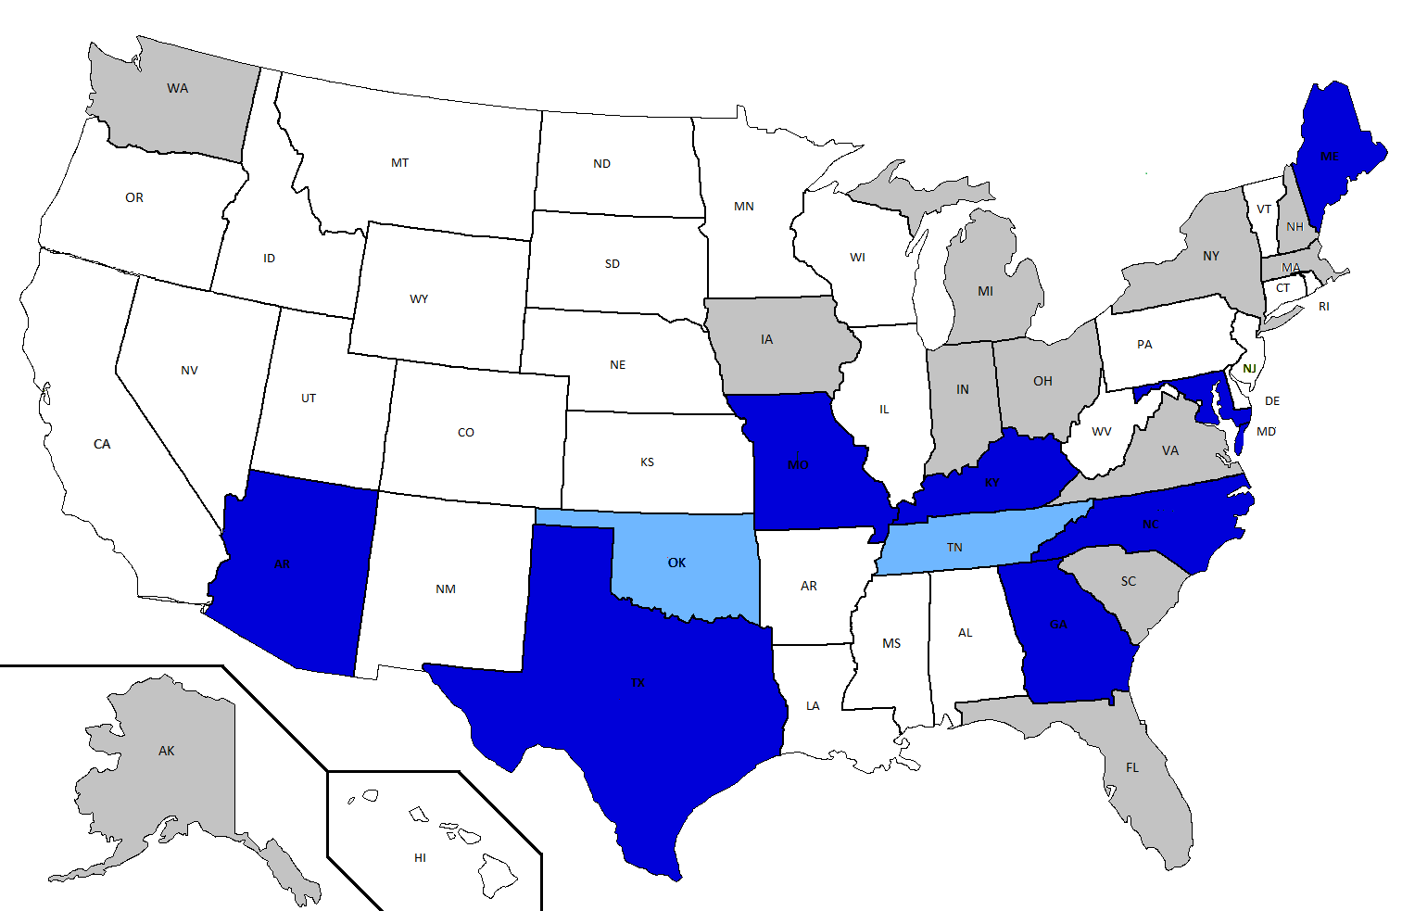
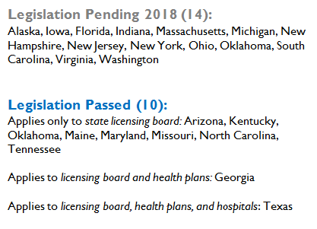
State Legislation Opposing the Use of Certification 2016-2018

Slide 15
Continuing Board Certification: Vision for the Future
A commission was approved in Q4 2017
Representation from multiple organizations/individual expected and encouraged
3 phases to the project:
  Building the foundation: a planning committee is formed
  Envisioning the Future: Engage stakeholders and gather information
  Considerations and Implementation: present a set of recommendations to ABMS and Member Boards for their implementation
Website established at visioninitiative.org

Slide 16
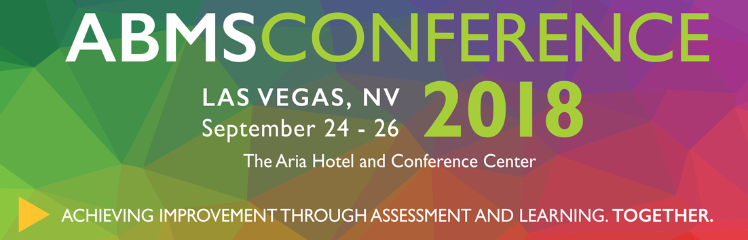

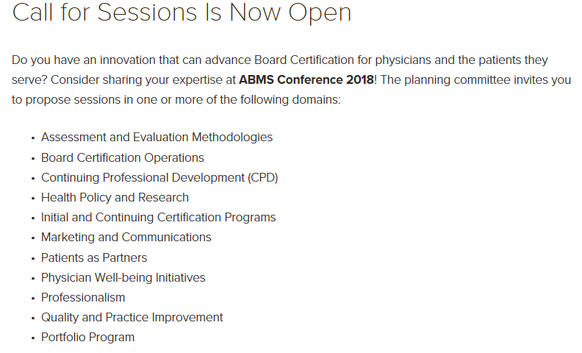

Slide 17

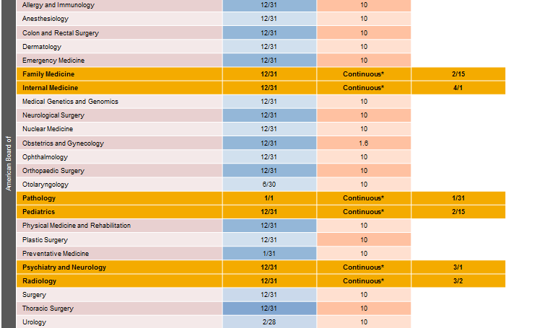

Appendix-ABMS MOC® /C-MOC Overview
ABMS
MOC
DISPLAY
All 24 ABMS Member Boards are now displaying whether the physicians they certify are meeting ABMS MOC requirements. Although not universally required as part of the credentialing process, ABMS MOC is recognized as a key quality marker by insurers, hospitals, quality organizations, and the federal government.

Slide 18
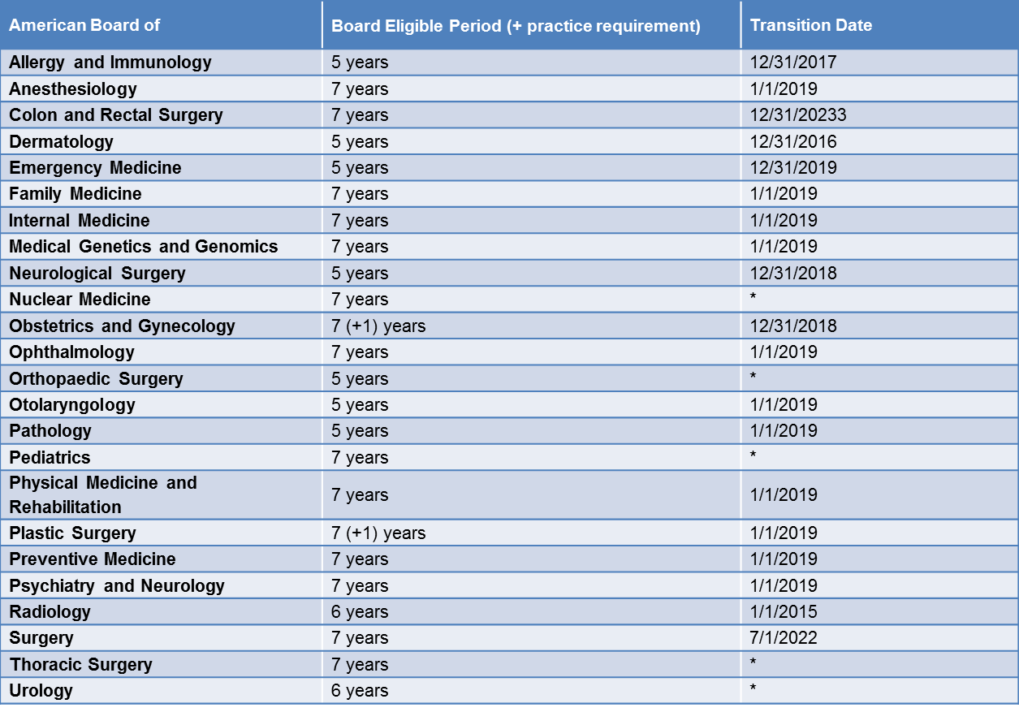
Appendix-Board Eligibility Policy
* These Member Boards had board eligibility policies in place prior to the effective date of the ABMS Board Eligibility Policy, and therefore no future transition date is provided.

